Slide 1


Slide 2
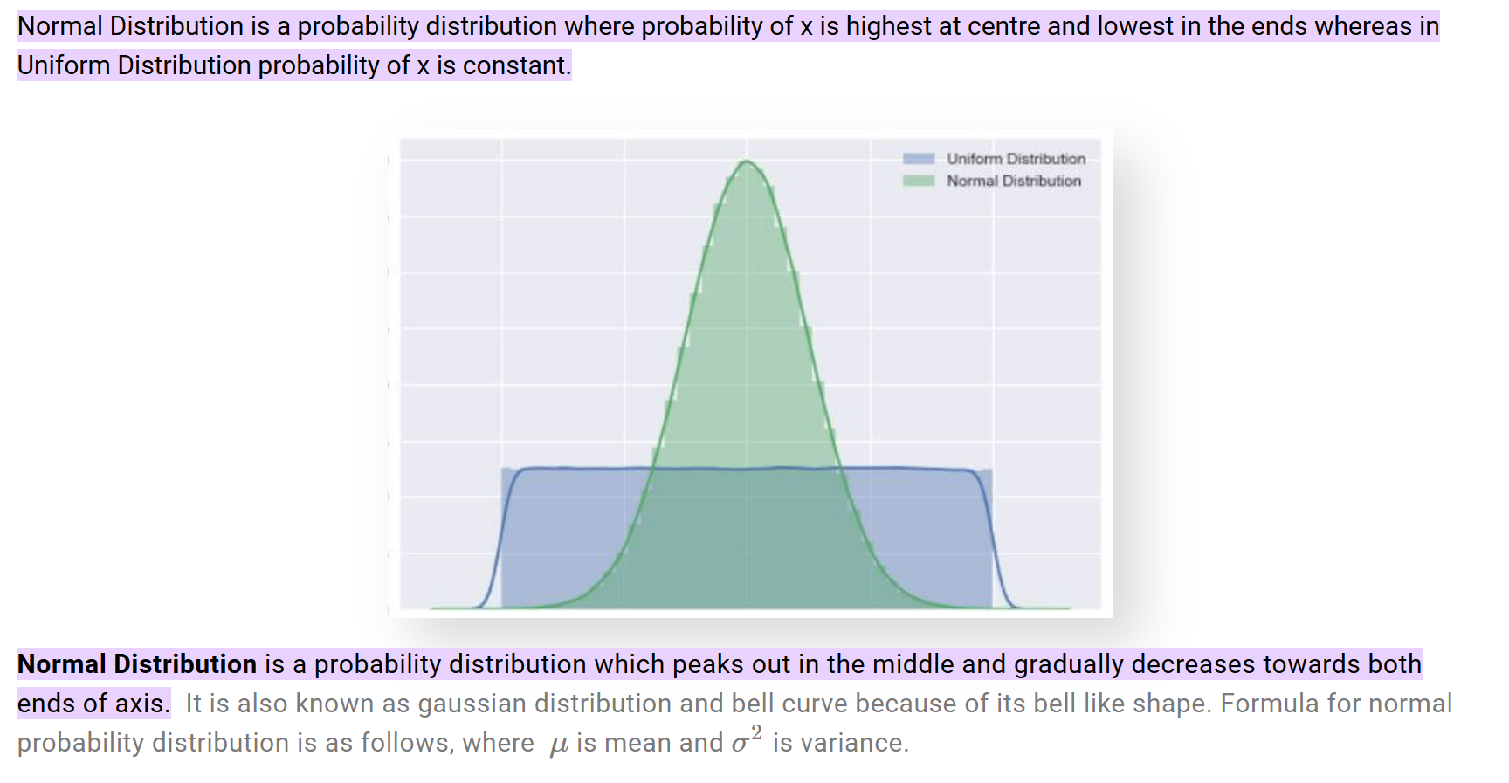
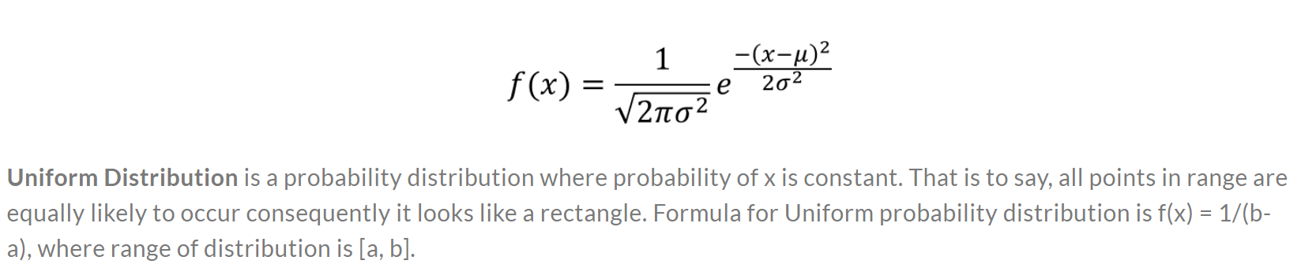
@amity1415

Slide 3
@amity1415
Bernoulli Distribution
Also called the binary distribution.
This is the kind of distribution that is present when flipping a coin. What this means is that for whatever your experiment or event may be, there are only two possible outcomes — Heads or tails, success or failure, 0 or 1, etc.
The probability of obtaining heads or tails for one flip would be 50% each.
Let’s say, kicking an extra point in football has a 75% success rate, and you represent 1 as a successful try, then the probability of 1 would be 75% and the probability of 0 would be 25%.

Slide 4
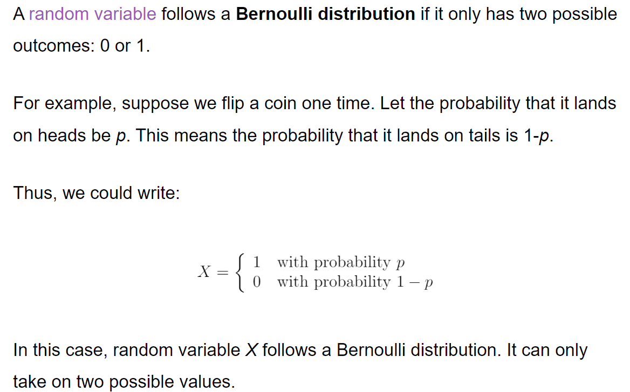
@amity1415

Slide 5


Bernoulli Distribution
@amity1415

Slide 6
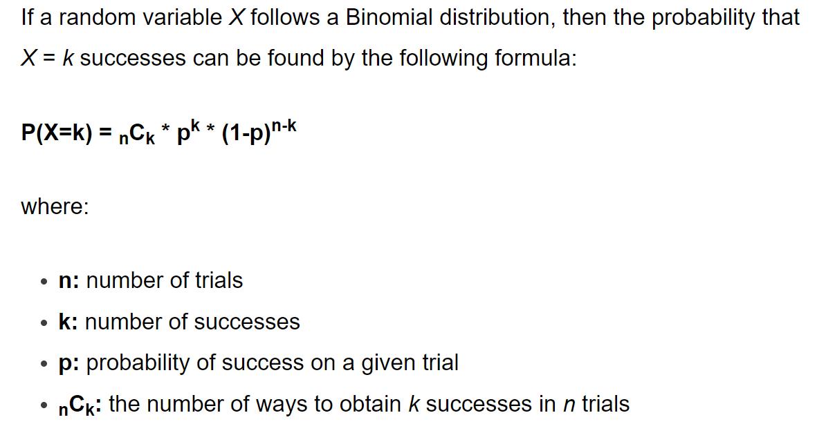
@amity1415
For example, suppose we flip a coin 3 times.
We can use the formula above to determine the probability of obtaining 0 heads during these 3 flips:
P(X=0) = 3C0 * .50 * (1-.5)3-0 = 1 * 1 * (.5)3 = 0.125
When n = 1 trial, the Binomial distribution is equivalent to the Bernoulli distribution.

